Slide 1
Objects and Classes

Slide 2
OBJECT
An object is a concrete entity or a thing that exists in the real world or in an abstract way.
  For example, files, employees, trains, television, cash, invoice, component, node, guidelines, tax, etc.
An object is:
  A tangible and/or visible thing
  Something that may be apprehended intellectually
  Something toward which thought or action is directed
It can be characterized by definite values and actions. Each object has its own responsibility. Each object possesses state, behavior, and identity.

Slide 3
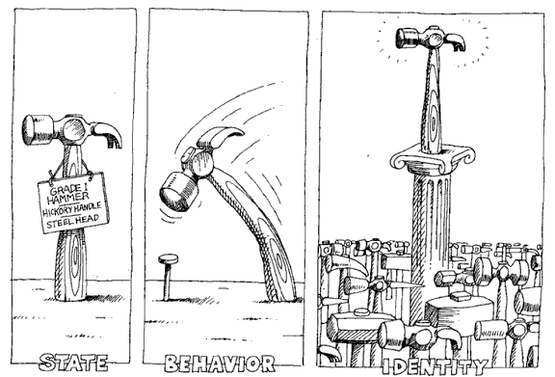
OBJECT
An object has state, exhibits some well-defined behavior, and has a unique identity.

Slide 4
OBJECT
Object State
An object is defined by its attributes and a set of values. The values have some type that may change over time.
For example, a person has his name, age, height, weight, residence, and qualification.
The state of an object encompasses all of the (usually static) properties of the object plus the current (usually dynamic) values of each of these properties.

Slide 5
OBJECT
Object State

Slide 6
OBJECT
Object Behavior
Behavior is how an object acts and reacts, in terms of its state changes and message passing.
Each object performs certain operations (positive or negative) depending on its state and values.
It means that each object behaves differently at different times. Thus, state and its operations together define the behavior of an object.
Each object in a state has certain role in which it performs responsibilities.

Slide 7
OBJECT
Object Behavior
The different roles of Joe are illustrated in Figure Given Below

Slide 8
OBJECT
Object Identity
Identity is that property of an object which distinguishes it from all other objects
Identity helps to uniquely identify an object in the real world.
It contains certain values.

Slide 9
CLASSES
A class is a set of objects that share a common structure, common behavior, common relationships with other objects, interactions, and common semantics.
A class has common attributes and operations.
Attributes are the properties of a class. An attribute is the data value held by an object of the class.
An operation is a service that can be requested by an object in a class.
An operation is implemented through methods of programming languages. Each operation has a name, signature, and its return type.
A signature specifies the number and type of arguments required to implement the operation.

Slide 10
CLASSES
The properties and operations of a class can be shared by other classes. A class can be refined into child classes known as subclasses.
A class that provides services to its subclass or other classes is known as a superclass. A class allows other classes to access services in a restricted manner.
In UML, visibility is used for the implementation of private, public, and protected access specifiers that inherit the services from their superclass. “#” is used for protected, “+” for public, and “–“ for private data and operations of a class.
Private access allows data to be accessed only by the class itself.

Slide 11
CLASSES
A typical structure of a class has three parts, viz., name, attributes, and operations.
An example of a class “Customer” for a retail store is shown in Figure Given below.

Slide 12
Encapsulation and Data Hiding
Encapsulation is the process of binding both attributes and methods together within a class.
Through encapsulation, the internal details of a class can be hidden from outside.
It permits the elements of the class to be accessed from outside only through the interface provided by the class.
Data Hiding: Typically, a class is designed such that its data (attributes) can be accessed only by its class methods and insulated from direct outside access.
This process of insulating an object’s data is called data hiding or information hiding.

Slide 13
MESSAGE PASSING
Objects communicate with each other by passing messages.
A message is a request for an operation or a service.
When a particular operation is to be performed, it is requested by an object by sending a message to the object for which the operation is defined.
Messages are implemented through procedure or function calls in the program. When the object receives the message, it will look for and execute the corresponding method.
A message has two parts, viz., object name and message with its parameters.
The getItem method can have itemID and itemName parameters. It can be written as:
S = Objectstore.getItem(getName, getID);

Slide 14
INHERITANCE
Inheritance is the mechanism that permits a class to share the attributes and operations defined in one or more classes.
The class which inherits from another class is called a subclass (also called a derived class) and the superclass (also called a base class) is a class from which another class inherits the behavior and data.
Inheritance decomposes software into a lower level of components and therefore it reduces the software complexity.
This is possible by method overriding in object-oriented programming.

Slide 15
Types of Inheritance
Single Inheritance : A subclass derives from a single super-class.
Multiple Inheritance : A subclass derives from more than one super-classes.
Multilevel Inheritance : A subclass derives from a super-class which in turn is derived from another class and so on.
Hierarchical Inheritance : A class has a number of subclasses each of which may have subsequent subclasses, continuing for a number of levels, so as to form a tree structure.
Hybrid Inheritance : A combination of multiple and multilevel inheritance so as to form a lattice structure.

Slide 16
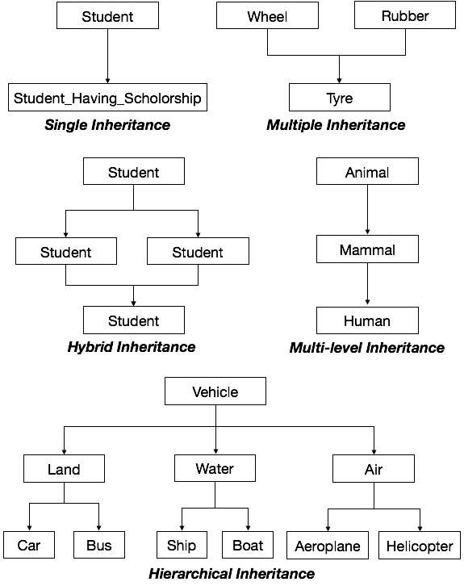

Slide 17
POLYMORPHISM
Polymorphism means an operation of a class behaves differently on different data values.
It is possible either by extending the capabilities of an operation in the subclass or overriding the same operation in the superclass.
Polymorphism is one of the most important features of object-oriented programming.
For example, addition operation can be performed on numbers to find the sum of numbers, on strings to concatenate the strings, and on files to merge files.

Slide 18
POLYMORPHISM
Polymorphism for ObjectsAdd operation

Slide 19
OBJECT RELATIONSHIPS
LINK AND ASSOICATION
A link represents the relationship between objects whereas an association is a relationship that connects classes.
Association is indicated by a line. Association can be a binary, ternary, or n-ary relationship.
Multiplicity defines how many instances of a class are associated with the instances of another class. It can be zero, one, or many.
A “*” is used for many and a line without any multiplicity indicates a one-to-one association.
The number specifies the number of instances in the association among classes.

Slide 20
LINK AND ASSOICATION
An association can also have attributes and it is represented by a box on the association line with a loop.
Role names are also used at the end of the association line to uniquely identify the object at the same end of association.
A qualifier can be attached with the association at the many side of the association line. It is indicated with a small box on the end of the association line close to the class diagram.
Ordering: Sometimes, the objects are explicitly ordered. An ordered set of objects on the “many” end of an association is indicated by writing “{ordered}” next to the multiplicity dot for the role

Slide 21
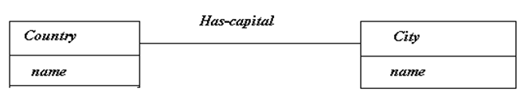


LINK AND ASSOICATION

Slide 22
LINK AND ASSOICATION
Association with multiplicity and qualifier

Slide 23
AGGREGATION
Aggregation is a kind of association that specifies a “whole-part” relationship between the aggregator and its components.
The smaller objects are assembled together to create a more generalized object. In aggregation, a single object is treated as a collection of objects.
The component object may be accessed through other objects without going through the aggregator.
The aggregator object is a more abstract object than its component objects.
A diamond is drawn at the assembly end of the relationship to represent aggregation.

Slide 24
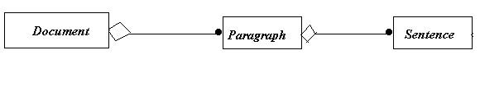
AGGREGATION

Slide 25
AGGREGATION
Aggregation of Windows system

Slide 26
COMPOSITION
It is dependent on the lifetime of the composite object. There exists a “has-a” relationship between the composite and the component objects.
The composite object has the ownership for the creation and destruction of the component objects.
Composition is stronger than aggregation because here there is dependency of component objects on the composite object.
For example, Students can register in a Course till its existence. As the Course is closed there is no possibility for student registration.

Slide 27
COMPOSITION
Composition for a course-student system

Slide 28
GENERALIZATION
Generalization represents a “is-a” relationship between the parent (superclass) and child (subclass) classes.
The subclass inherits the properties of the superclass.
The parent class represents the most general class and the child class is a more specific class.
Generalization is implemented using inheritance in an object-oriented programming language.
Generalization allows finding attributes, operations, and relationships in a parent class and then reusing them in child classes.
In UML, generalization is shown as an arrow from the child to the parent, with a large hollow triangle at the association end to the parent.

Slide 29
GENERALIZATION
Generalization for a telephone system

Slide 30
DEPENDENCY
Dependency is the relationship between two objects in which a change in one object may affect the other object.
For example, if an object A uses another object B, then A depends on B. That is, A cannot be developed without using B. Thus, class A and class B are coupled to each other.
The coupling between dependent objects can either be loose (i.e., weak dependencies) or tight (i.e., strong dependencies).
Dependency is represented by a dashed directed line, directed to the class which is depended upon with the stereotype, which distinguish its kind.

Slide 31
DEPENDENCY
A stereotype is a tag used to indicate the type of a construct so that it can be distinguished from other constructs.
A stereotype is shown by guillemets (« »). Different entities, attributes, and associations have different types.
The stereotype extends and identifies their capabilities with other types.
Each stereotype has semantics associated with it.
There are various types of stereotype dependencies, such as «realization», «abstraction», «binding», «substitution», «usage», etc.

Slide 32
DEPENDENCY
Dependency relationship

Slide 33
REALIZATION
Realization is a semantic relationship where one class specifies a contract which another class carries out.
In realization, one classifier provides the specifications and the other classifier ensures the implementation.
Realization is observed in the context of interfaces and collaborations. Classes and components use realization.
A realization dependency is shown with a dashed line with a triangular arrowhead at the end, which corresponds to the realized element.
Realization allows reusing the operations of types and interfaces, where a realization element is said to realize its specification elements.

Slide 34
REALIZATION
Realization relationship
In the example, the academic rules and fees preferences that are set using the sponsored student interface are being implemented by the student.

